Slide 1


E-commerce Case Study
Maroon Consulting
Jocelyn Chen, Deepali Dagar, John Fitzgerald, Sam Luo, Bruna Medeiros, Kunal Mody
December 9, 2024

Slide 2
Agenda
1 | Team Introduction
2 | Solution Overview
3 | Modeling Process
4 | Model Results & Business Value
5 | Deployment & Adoption Strategy

Slide 3

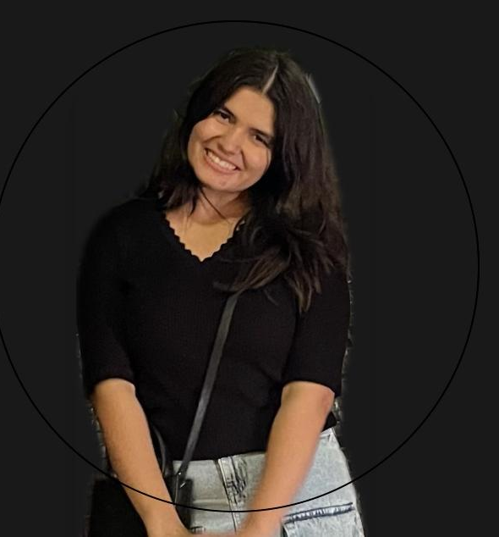




Team Introduction
John Fitzgerald
Team Leader
Deepali Dagar
Researcher
Bruna Medeiros
Researcher
Jocelyn Chen
Workflow Coordinator
Sam Luo
Technical Mentor
Kunal Mody
Technical Mentor
Team Introduction
Solution Overview
Modeling Process
Model Results & Business Value
Deployment & Adoption Strategy

Slide 4


About Us
Maroon Consulting
was born out of University of Chicago MS-ADS program in 2014.
MISSION
Our mission is to deliver the best data-driven solutions tailored to each client’s unique needs, fostering growth and innovation in their endeavors.
VALUES AND CULTURE
Through an environment of collaboration, meritocracy, and excellence, we aim to empower organizations to make informed decisions and achieve lasting success.
Team Introduction
Solution Overview
Modeling Process
Model Results & Business Value
Deployment & Adoption Strategy

Slide 5




Our Impact and Expertise
McDonald’s All-Day Breakfast
Fitness Center Retention
Verizon Impact Application
Identified key drivers in a regional promotion and optimized marketing strategies to boost ROI.
Coordinated with CMO and Regional Leads to roll-out marketing plan.
Improved member retention and minimized churn rates through data-driven strategies.
Minimized churn by 20% compared to baseline in the year after implementation.
Accurately forecasted customer default probabilities, reducing financial losses and maximizing gains.
Developed a predictive, data-driven application to enhance economic impact improving original model’s ROI by $27 million per 1 million applicants.
Team Introduction
Solution Overview
Modeling Process
Model Results & Business Value
Deployment & Adoption Strategy

Slide 6
Background
Background
The book e-commerce market is experiencing remarkable growth, projected to reach USD 23.12 billion by 2026, with a compound annual growth rate of 4.9%¹. Digital transformation and changing consumer behaviors are reshaping how books are discovered, purchased, and consumed.
Despite the availability of extensive customer data, many online bookstores still rely on basic "most popular" recommendation systems, with many readers reporting frustration from receiving suggestions for books they've already purchased.
Main Challenge
Business Opportunity
Enhance customer engagement
Increase average order value
Create meaningful connections with readers
Drive personalized marketing campaigns
¹: AppleWorld.Today. (2021, February 10). Global e-book market expected to see strong growth through 2026. AppleWorld.Today.
https://appleworld.today/2021/02/global-e-book-market-expected-to-see-strong-growth-through-2026/
Team Introduction
Solution Overview
Modeling Process
Model Results & Business Value
Deployment & Adoption Strategy

Slide 7

Problem Statement
Problem Statement
Opportunities
Background
Current recommendation system treats all readers identically, missing opportunities to leverage rich customer data for better recommendations and increased sales.
Higher Sales
By focusing on the top 15% of engaged customers, we can achieve significant revenue growth (estimated +20%) while also driving small but meaningful improvements across other segments
Understanding Our Customers
What they prefer (e.g., genres or product categories).
How often they shop, what they buy, and how much they spend.
Model Evaluation and Promotion
Success will be measured through increased conversion rates, higher average order values, and improved customer engagement metrics across segments.
Team Introduction
Solution Overview
Modeling Process
Model Results & Business Value
Deployment & Adoption Strategy
Notes:
Instructions:
For this presentation, assume that your approach can be reasonably expected to deliver +20% incremental sales among the most engaged 15% of customers and deliver a statistically significant but small improvement (3–5%) among other customers. With these results, you and the CTO do not expect the CMO and Webmaster to allow the change of algorithm for all portions of the customer base. However, you believe the CMO and Webmaster will accept your approach for the top 15% of customers.

Slide 8

Solution Summary
Segmentation
Data Processing & Cleaning
First K-means Clustering
Second K-means Clustering
Identified data patterns/trends like most popular genres
Detected outliers and monetary skewness
Clustering based on:
Recency: Time since last purchase.
Frequency: Number of purchases.
Monetary: Total money spent.
Resulted in 4 total clusters
Clustering based on each client’s preferred genre.
Creates 2 clusters for each initial cluster (total of 8 clusters)
Team Introduction
Solution Overview
Modeling Process
Model Results & Business Value
Deployment & Adoption Strategy
Notes:
Kunal

Slide 9
Personas
Low Customer Lifetime Value
High Customer Lifetime Value
Lost Clients
At Risk
Can’t Lose
Stars
1st Clustering
Recency:
Very High
Moderate
Moderate
Very High
Frequency:
Low
Low
Very High
High
Monetary:
Moderate
Low
High
Very High
Scale:
Very Bad
Bad
Average
Good
Very Good
The Above Personas Breakdown into The Below Sub-Clusters based on Genre Preferences
Realists
Realists
Realists
Realists
2nd Clustering
or
or
or
or
Explorers
Explorers
Explorers
Explorers
Team Introduction
Solution Overview
Modeling Process
Model Results & Business Value
Deployment & Adoption Strategy

Slide 10
1st Level Clustering
The first level of analysis used to create “personas” captures the behavior that characterizes the Customer Lifetime Value (CLV) of each customer
Low Customer Lifetime Value
High Customer Lifetime Value
Lost Clients
At Risk
Can’t Lose
Stars
Recency:
Very Low
Moderate
Moderate
Very High
Frequency:
Low
Low
Very High
High
Monetary:
Moderate
Low
High
Very High
Scale:
Very Bad
Bad
Average
Good
Very Good
Team Introduction
Solution Overview
Modeling Process
Model Results & Business Value
Deployment & Adoption Strategy

Slide 11
2nd Level Clustering
The second level of analysis used to create “personas” captures the unique interests of customers and is used for enhance personalization beyond their CLV characteristics.
Realists
Explorers
Clients interested in every-day, mundane, common genres:
Clients interested humanities or travel related genres:
Examples:
Examples:
Sport
Game Riddles
Economy
Cartoons
Politics
Non-Books
Health
Science
Learning
History
Travel Guides
Maps
Contemporary History
Religion
Encyclopedia
Linguistics
Team Introduction
Solution Overview
Modeling Process
Model Results & Business Value
Deployment & Adoption Strategy

Slide 12
Summary of Personas
Eight clusters in total:
1st Level Clustering: 4 clusters
2nd Level Clustering: 2 Sub-Clusters, each
Low Customer Lifetime Value
High Customer Lifetime Value
Lost Clients
At Risk
Can’t Lose
Stars
Realists
Explorers
Realists
Explorers
Realists
Explorers
Realists
Explorers
Strategic Marketing:
We will recommend a specific discount and message for each of the four clusters.
Then, for each sub-cluster, adjust the recommended genres to their preference.
Team Introduction
Solution Overview
Modeling Process
Model Results & Business Value
Deployment & Adoption Strategy

Slide 13
Combined Marketing Messaging
Strategic Marketing:
We will recommend a specific discount and message for each of the four clusters.
Then, for each sub-cluster, adjust the recommended genres to their preference.
Lost Clients
At Risk
Can’t Lose
Stars
Discount
1-5% off
2% off or personalized offer to re-engage
3% off or Loyalty Rewards (points of free shipping)
Early access to releases of exclusive bundles
"We miss you! Reignite your curiosity with captivating reads in [Preferred Genres]!"
"Don’t miss out! Rediscover your favorite reads and enjoy personalized offers tailored for you."
"Thank you for your loyalty! Enjoy these exclusive recommendations, tailored just for you, to keep your reading journey exciting!"
"As one of our top readers, you deserve the best! Check out these exclusive offers curated just for you!"
Message
Suggestion
Preferred genres and/or new genres.
Related genres.
Related genres.
Premium books or rare editions of favorite genres.
Customers that have not engaged in a long time. They need an attractive discount and a personalized push to remind them of the value they can derive from your bookstore.
Showing signs of churn with moderate recency and low frequency. A personalized offer with related genres can prevent them from leaving entirely.
Were highly active and frequent buyers. Losing them would have a disproportionate impact on sales. Therefore, recommend new, but related genres of preference to keep them interested.
Customers who spends significantly and are highly engaged. They value exclusivity and premium experiences, so ensuring those are maintained is essential.
Rationale
Team Introduction
Solution Overview
Modeling Process
Model Results & Business Value
Deployment & Adoption Strategy

Slide 14
Business Value
Optimized Strategy Increases Revenue by 4.29%
Current Revenue | Estimated Revenue | Revenue After Discount
$1,278,100 | $1,533,725 | $1,533,724
Top 15%
Current Revenue | Estimated Revenue | Revenue After Discount
$7,214,021 | $7,507,883 | $7,324,240
Remaining customers
Current Revenue:
$8,493,129
Predicted Revenue:
$8,857,964
Revenue: $364,836*
*Specific calculations and assumptions can be found in the appendix
Team Introduction
Solution Overview
Modeling Process
Model Results & Business Value
Deployment & Adoption Strategy
Notes:
By using our strategy, We expect to deliver 20% incremental sales among the most engaged 15% of customers and 2-5% amongst other customers. Our current revenue is 8.4 million, After calculating the discounts that bruna talked about we expect 8.85 million, In total we are expecting Three hundred 64 thousand dollars more revenue than the current

Slide 15
Implementation Strategy
A
Pilot Deployment
Collaborate with CMO and Webmaster to create pilot deployment strategy.
Start with top 15% most engaged customers.
Tailor recommendations based on the customer segment.
B
Collect performance data from the pilot.
Measure KPIs such as conversion rate uplift, AOV, and retention.
Phased rollout with A/B testing.
Continuous monitoring and optimization.
Refine the Recommendation Engine
C
Automate data pipelines to update clusters dynamically as new data arrives.
Ensure scalability and minimal downtime during deployment.
Set up automated monitoring and reporting systems
Data Integration
Team Introduction
Solution Overview
Modeling Process
Model Results & Business Value
Deployment & Adoption Strategy
Notes:
Our plan is to do pilot deployment with top 15% of the customers and then later refined the recommendation engine as per the results we get from our first implementation by . We also plan to automate the data pipeline to update data and clusters time to time

Slide 16
Timeline
Workstream | Dec 10 - Jan 5 | Jan 6 - Jan 15 | Jan 15- Jan 30 | Jan 30- Feb 15 | Feb 15- Mar 25
Phase 1
Phase 2
Phase 3
Phase 4
Phase 5
Pilot with top 15% segment (2 months).
Evaluate initial pilot outcomes and refinement process.
Expansion Feasibility Assessment
Pilot with all segments
Final refined Implementation
Dec 20: Ensure readiness for the pilot launch, addressing key metrics, and initial segmentation setup.
Jan 10: Assess early pilot results and refine strategies based on customer engagement insights.
Jan 20: Evaluate final pilot results to assess feasibility for broader rollout..
Feb 5: Discuss scalability of the approach and plan for full implementation.
Mar 20: Finalize rollout strategies and gain full approval for complete implementation.
Key Check-in Meetings
Team Introduction
Solution Overview
Modeling Process
Model Results & Business Value
Deployment & Adoption Strategy

Slide 17



Summary
Our Solution
Building an RFM model based on K-means for classifying.
Identify the consumption intentions of different customer groups and tailor sales strategies to suit local conditions.
Business Value
The estimated additional revenue is $ 364,835 which brings significant economic benefits.
Personalized recommendation algorithms help to enhance user retention and the perception of user consumption.
Implementation
Conduct an algorithm pilot among the top 15% customers.
Establish a timeline for optimizing and improving the algorithm, and gradually roll out the algorithm to more consumers.
Team Introduction
Solution Overview
Modeling Process
Model Results & Business Value
Deployment & Adoption Strategy

Slide 18
Appendix
Notes:
Ariel

Slide 19
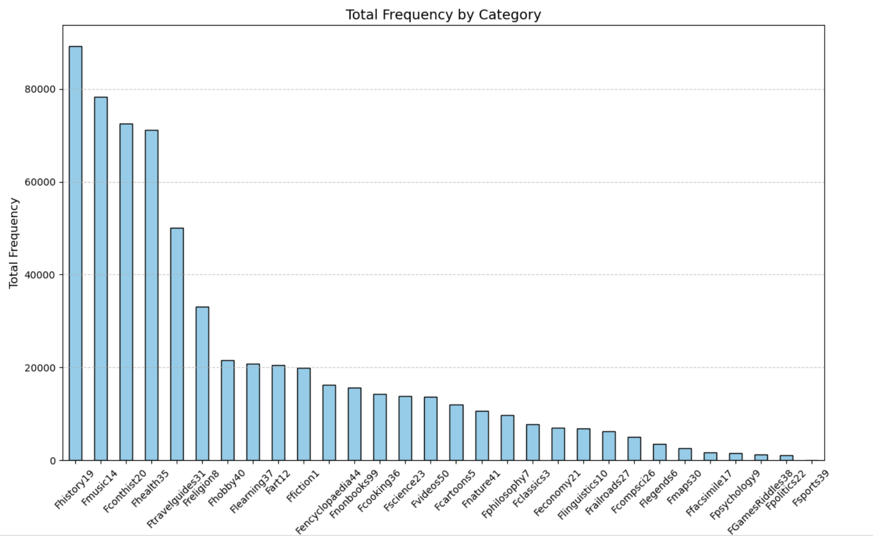
Distribution of Genres
Top Sellers: History, Music, Contemporary history dominate sales and revenue.
Balanced Demand: Genres like hooby and learning show consistent performance.
Low Performers: Niche genres (e.g., Maps, Sports) contribute minimally, offering growth potential.
Team Introduction
Solution Overview
Modeling Process
Model Results & Business Value
Deployment & Adoption Strategy

Slide 20
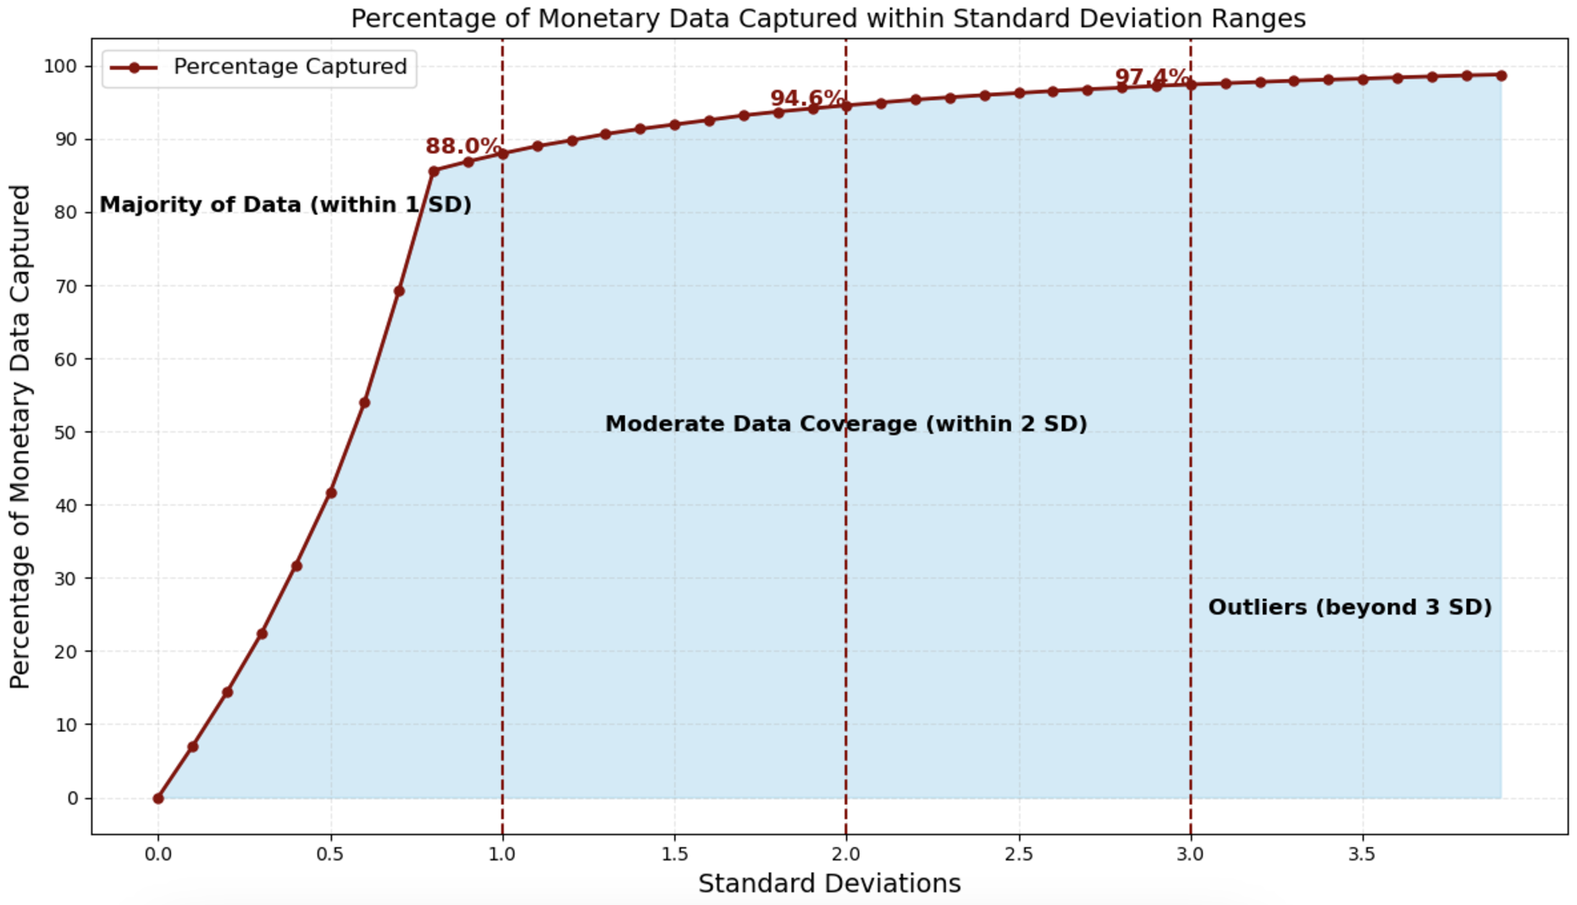
Outlier Analysis
Distribution of customer sales (monetary values) is hugely right skewed, with a majority of values concentrated towards lower sales
Outliers may have an impact on clustering models
Elbow method for determining cutoff for outliers
Most data (88%) captured lies < 1 standard deviation away
Team Introduction
Solution Overview
Modeling Process
Model Results & Business Value
Deployment & Adoption Strategy

Slide 21
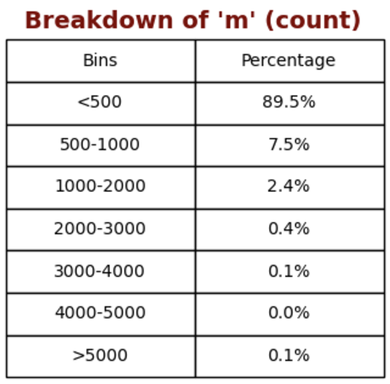
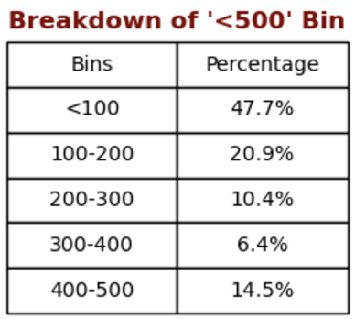
EDA/Insights
Monetary (variable “m”)
Range: $0 to $532,892
Insights:
Significant Spending Concentration: 89.5% of clients have spent less than $500 in total, with nearly half (47.7%) spending under $100, indicating a heavily skewed distribution toward lower-value customers.
Customer Segmentation Pattern:
Core Low-Value Segment: 47.7% spend under $100
Mid-Value Segment: 31.3% spend between $100-300
Premium Segment: Only 0.6% spend over $3000
Team Introduction
Solution Overview
Modeling Process
Model Results & Business Value
Deployment & Adoption Strategy

Slide 22
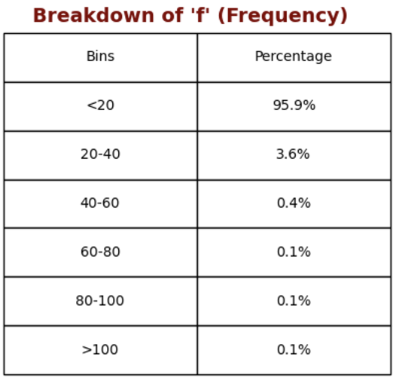
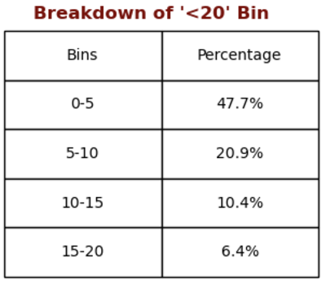
EDA/Insights
Frequency (variable “f”)
Range: 0 to 118
Insights:
Highly Infrequent Usage Pattern: 95.9% of clients engage less than 20 times, showing a heavily concentrated pattern of low-frequency usage.
User Engagement Breakdown::
Majority Low-Frequency Users: 47.7% engage only 0-5 times
Occasional Users: 20.9% engage 5-10 times
Regular Users: 10.4% engage 10-15 times
Highly Active Users: Only 0.2% engage more than 80 times
Team Introduction
Solution Overview
Modeling Process
Model Results & Business Value
Deployment & Adoption Strategy

Slide 23
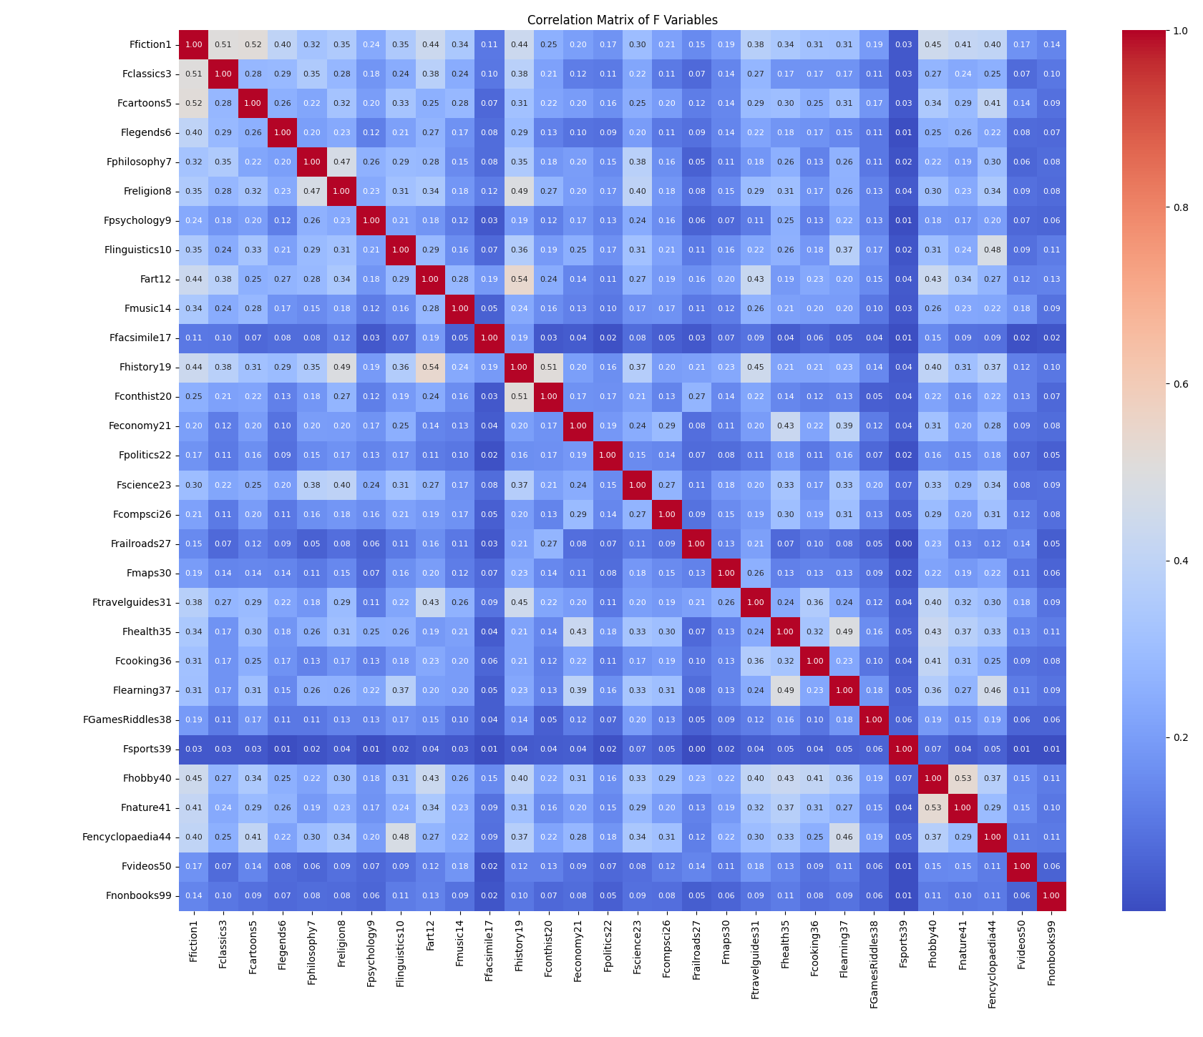
EDA/Insights: Correlation Matrix for f Variables
The lighter the color, the higher the correlation.
It can be observed that variables 1, 10, 19, and 44 have a higher correlation with other variables.
These correlations suggest that some customers may purchase other items when buying a particular product, and if we can grasp these relationships, it will undoubtedly generate additional commercial benefits.
Team Introduction
Solution Overview
Modeling Process
Model Results & Business Value
Deployment & Adoption Strategy

Slide 24
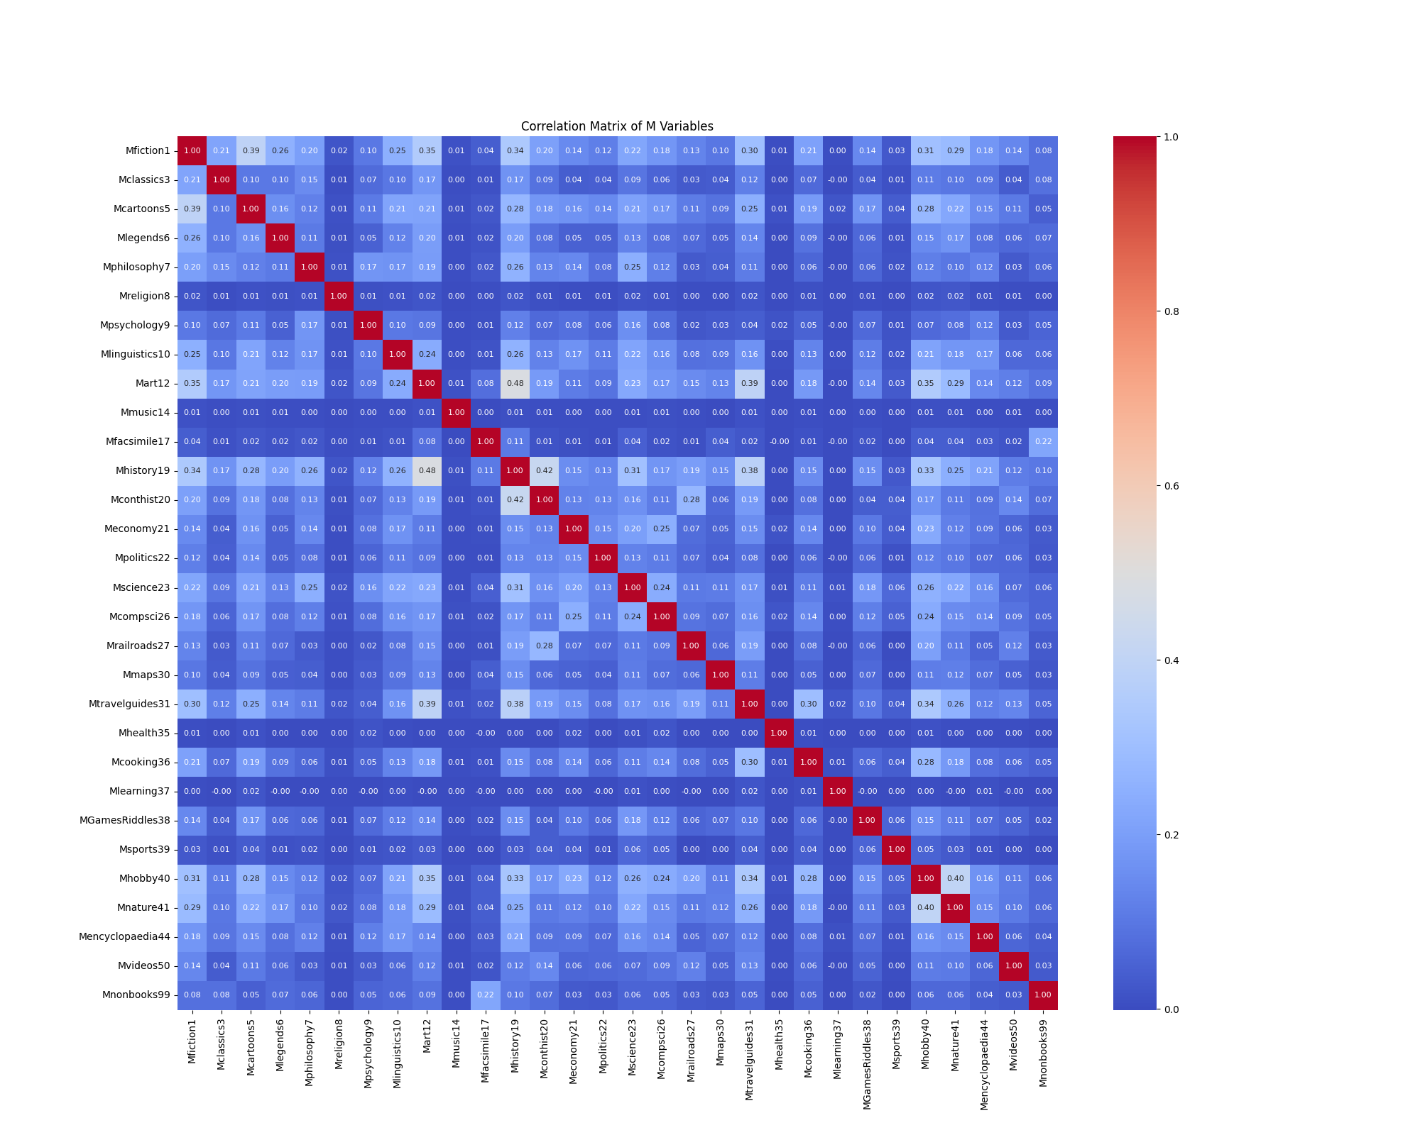
EDA/INSIGHTS Correlation Matrix for M Variables
The lighter the color, the higher the correlation. It can be observed that variables 18 and 40 ave a higher correlation with other variables.
The correlation matrix of F and M shows differences, indicating that they each contain independent information, which will have separate effects during clustering.
Team Introduction
Solution Overview
Modeling Process
Model Results & Business Value
Deployment & Adoption Strategy

Slide 25
Model Selection
Selecting K-Means for creating a recommendation system based on customer segments is the preferred option. With a silhouette score of 0.50, there are moderate cluster performance, but K-Means is highly interpretable for the business to create personalized recommendations and is MECE, meaning that all new customers will be assigned to a group.
Model | MECE (Y/N) | Strengths | Weakness
DBSCAN | No | Detects arbitrary shapes and outliers | Struggles with high-dimensional, sparse e-commerce data; not ideal for large datasets
GMM | No | Handles overlapping clusters with probabilistic assignments | Less interpretable for business stakeholders; slower with large datasets.
Light GBM | Yes | Classification | Not designed for unsupervised segmentation; requires labeled data for training
K-Means | Yes | Simple, efficient, and interpretable | Assumes spherical clusters; may oversimplify customer behavior in complex datasets
Team Introduction
Solution Overview
Modeling Process
Model Results & Business Value
Deployment & Adoption Strategy

Slide 26
Building the Best Clustering for Business Outcomes
Step
Description
Outcome
1.
High Level RFM Clustering
Utilized K-Means on Recency, Frequency, Monetary Value, and Time On File being open
Enables strategic allocation of marketing based on customer lifetime value derived from RFM
2.
Sub-Clustering Based on Genre Preferences
Within each High Level RFM Cluster, clustered on Genre Categorizes
Provides deeper insights into customer tastes and interests for more refined targeting
3.
Identify Unique Personas
Used the differentiators within Sub-Clusters to find unique attributes for customers in them
Highlights unique behaviors and attributes that can be used by business units
4.
Create Personalized Marketing Strategy & Recommendations
Identified the unique products, messaging, and offers to recommend the personas
More effectively design tailored marketing, product recommendations, etc.
Team Introduction
Solution Overview
Modeling Process
Model Results & Business Value
Deployment & Adoption Strategy

Slide 27
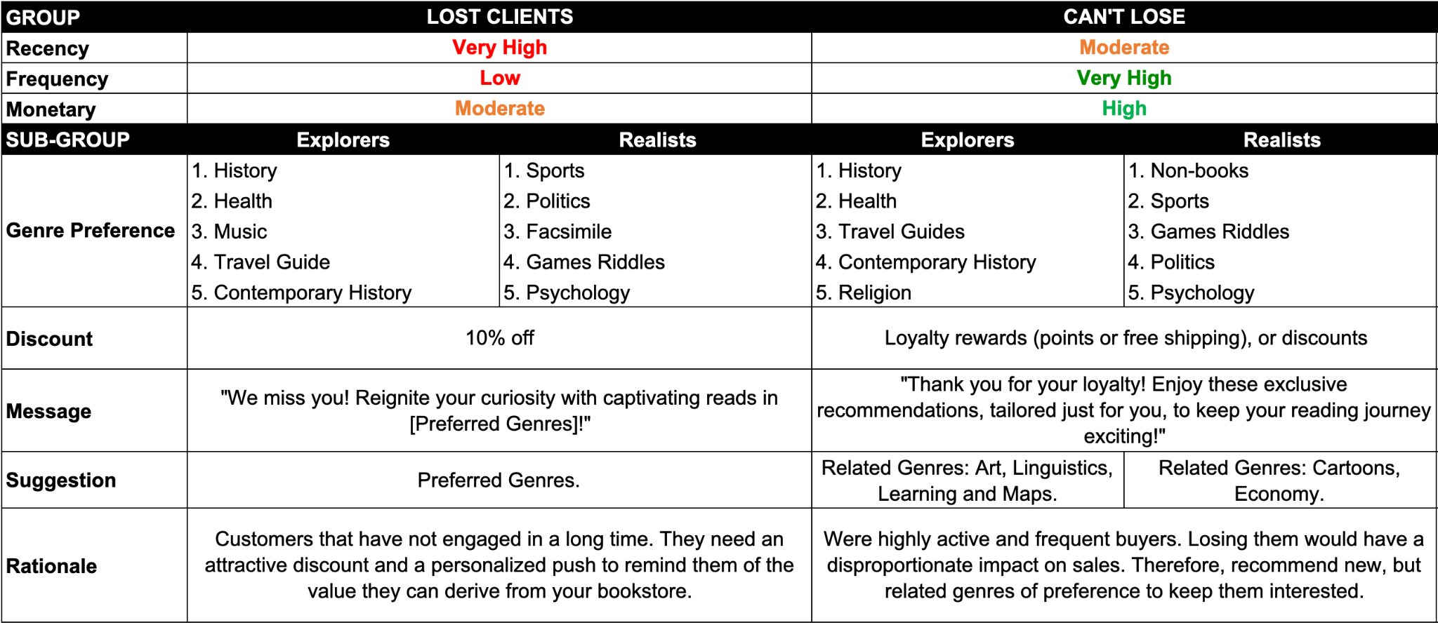
Persona Results
Step 1: Clustering based on R, F, M and Time on File metrics, resulting in 4 clusters.
Step 2: Divide each into 2 subclusters each, based on preferred genres, totaling 8 clusters.
Step 1:
Step 2:
Team Introduction
Solution Overview
Modeling Process
Model Results & Business Value
Deployment & Adoption Strategy
Notes:
Kunal

Slide 28
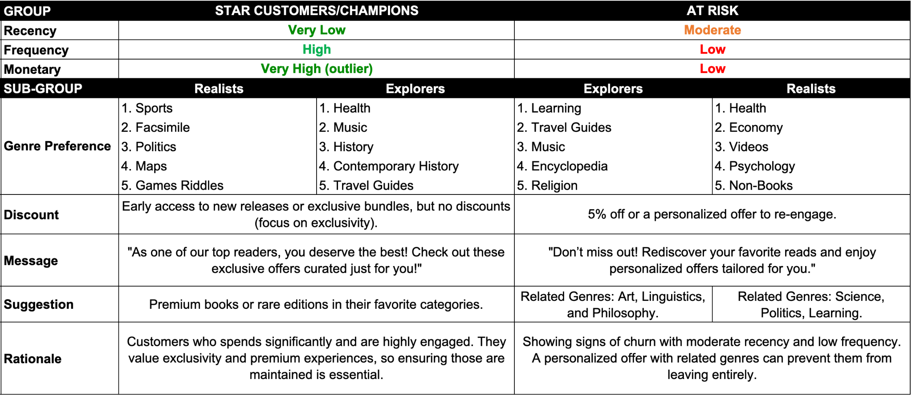
Persona Results
Step 1: Clustering based on R, F, M and Time on File metrics, resulting in 4 clusters.
Step 2: Divide each into 2 subclusters each, based on preferred genres, totaling 8 clusters.
Step 1:
Step 2:
Team Introduction
Solution Overview
Modeling Process
Model Results & Business Value
Deployment & Adoption Strategy
Notes:
Kunal

Slide 29
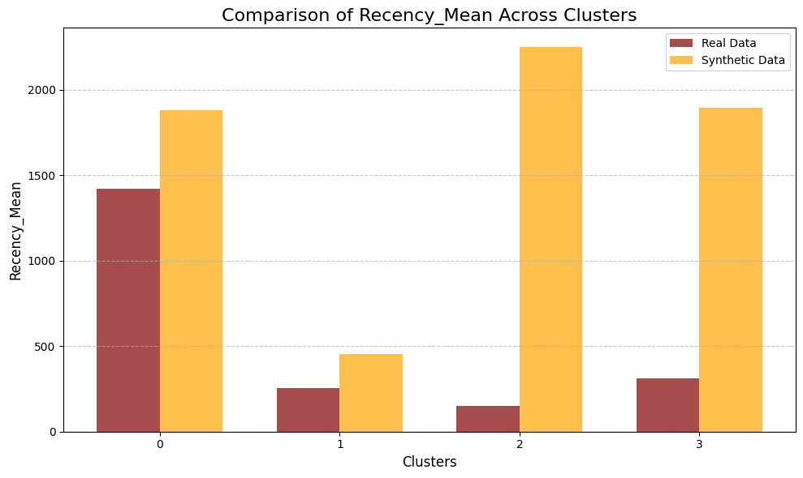
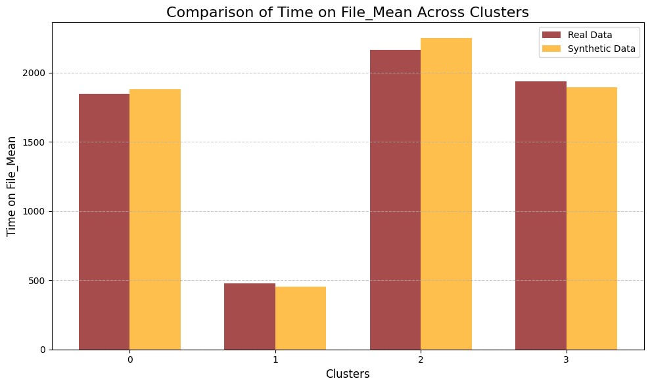
Next Steps - Synthetic Data Validation
Purpose:
Validate model performance using realistic synthetic data that mimics real-world distributions.
Method:
Technique:Conditional Tabular GAN
Process:
Trained a generative model to learn data distributions.
Generated realistic synthetic data for validation.
Result:
Clusters in synthetic data align closely with those in real data.
The result demonstrates robustness of the model across diverse datasets.
Team Introduction
Solution Overview
Modeling Process
Model Results & Business Value
Deployment & Adoption Strategy

Slide 30
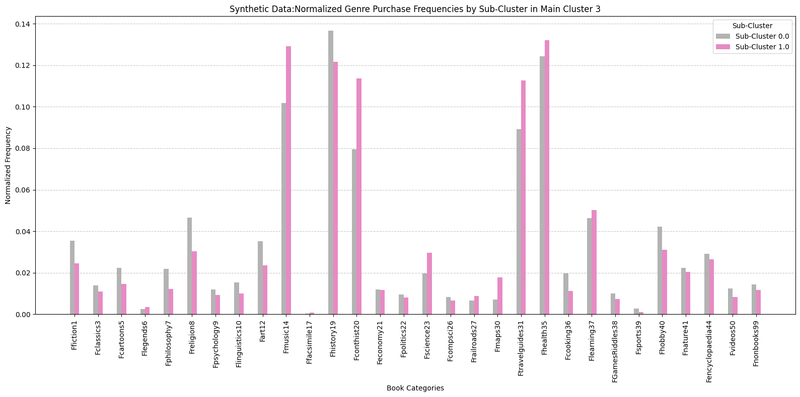
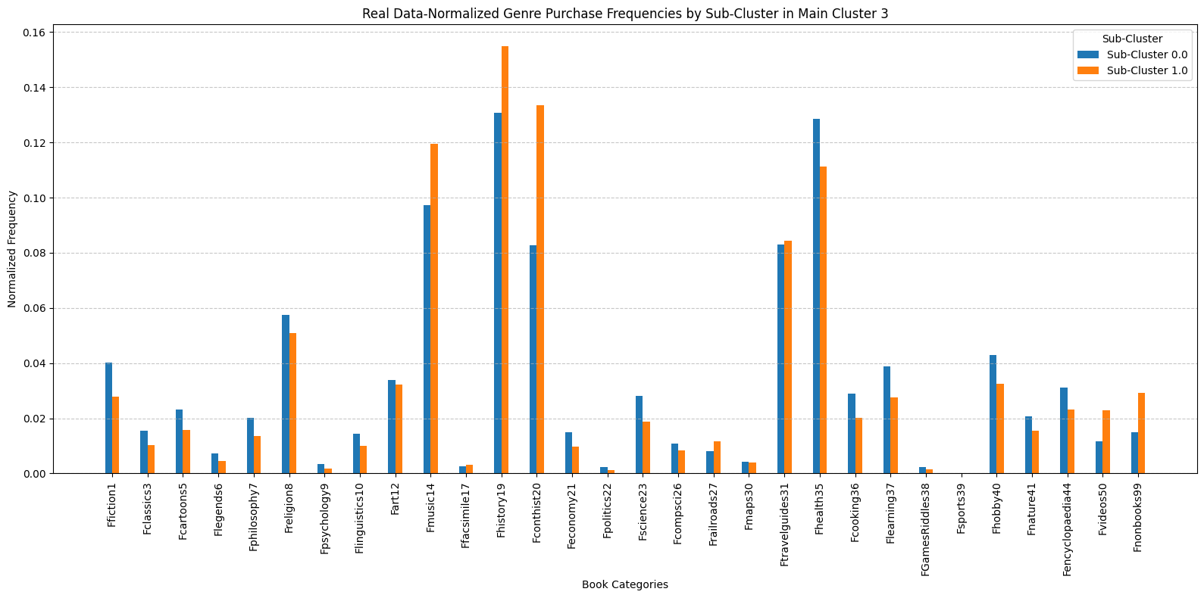
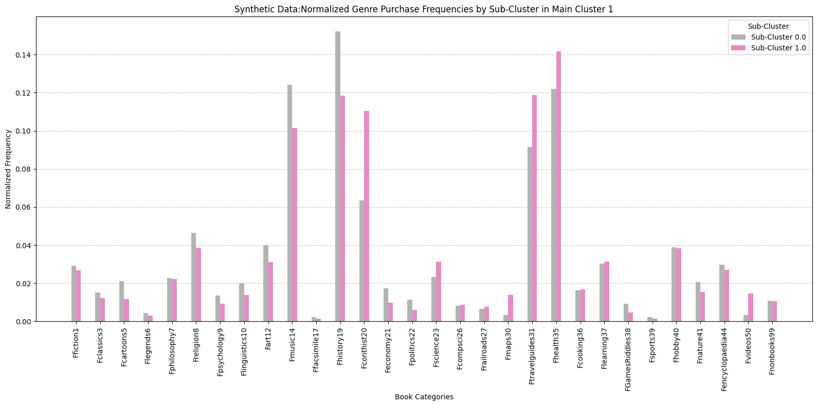
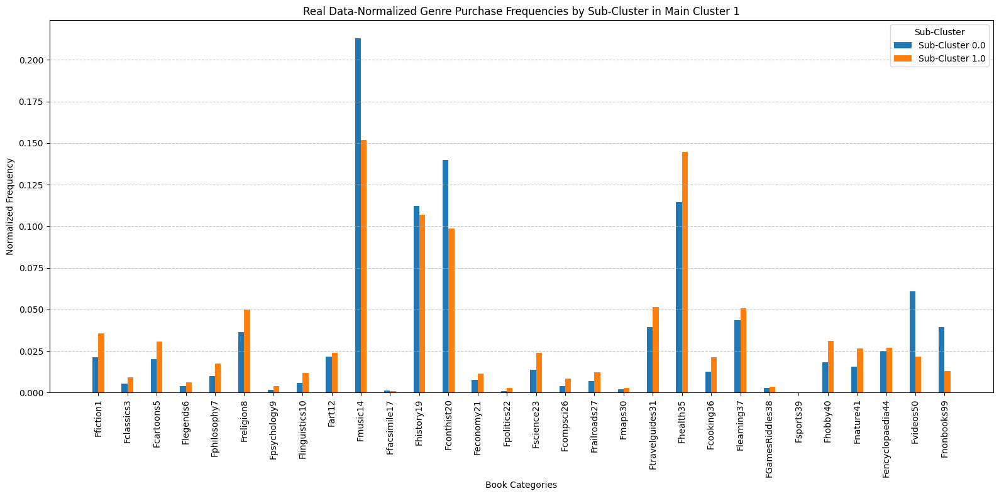
Synthetic Data vs Real Data
Team Introduction
Solution Overview
Modeling Process
Model Results & Business Value
Deployment & Adoption Strategy

Slide 31
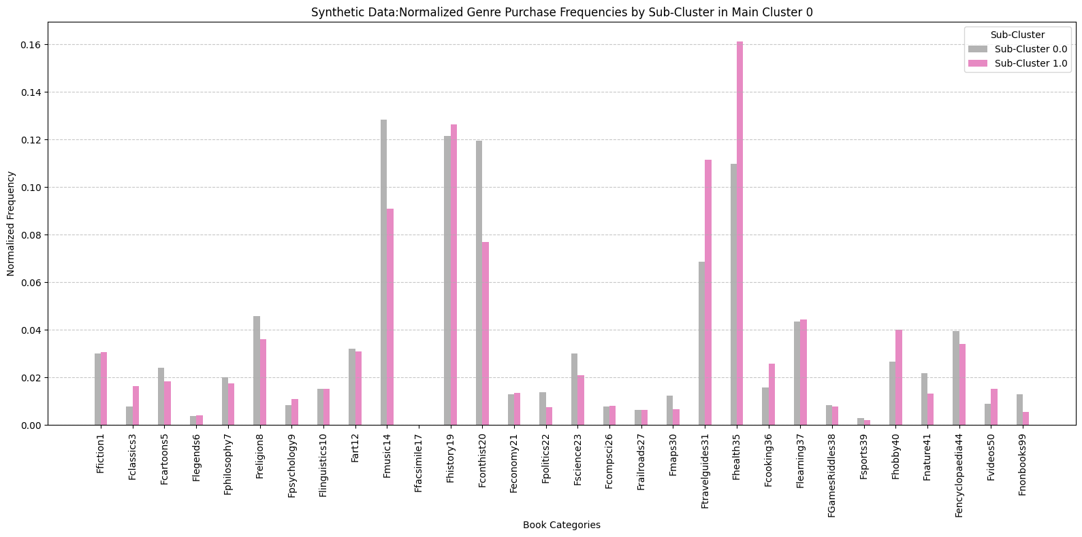
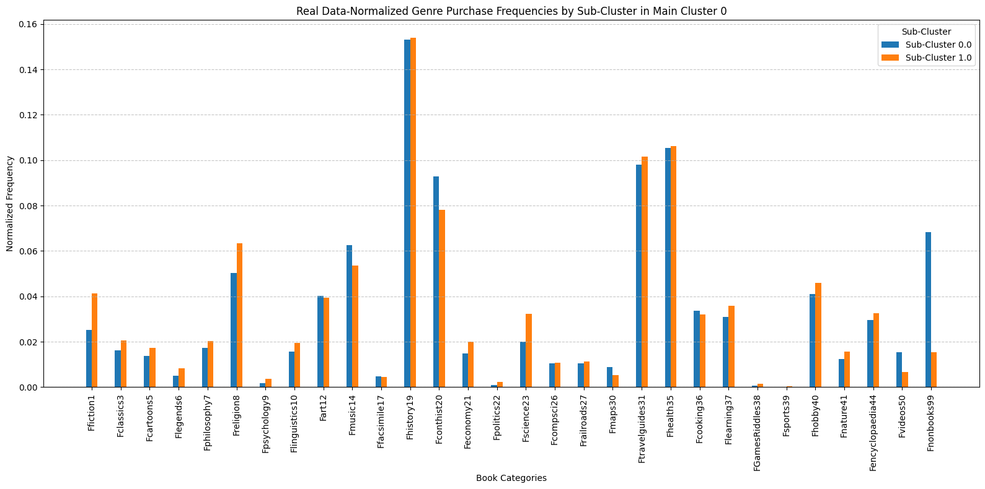
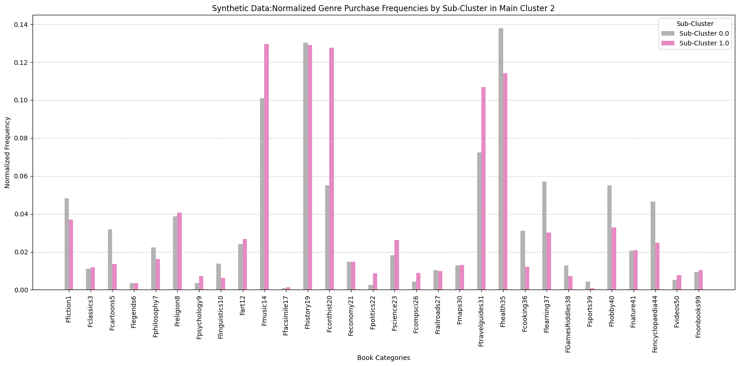
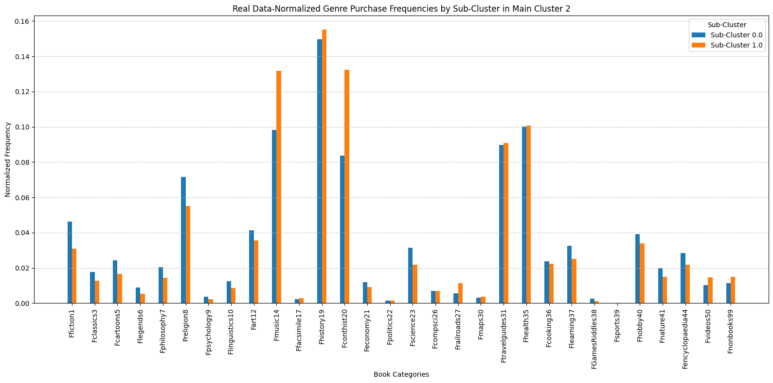
Synthetic Data vs Real Data
Team Introduction
Solution Overview
Modeling Process
Model Results & Business Value
Deployment & Adoption Strategy

Slide 32
Synthetic data- Sample
index | id | r | f | m | tof | Ffiction1 | Fclassics3 | Fcartoons5 | Flegends6 | Fphilosophy7 | Freligion8 | Fpsychology9 | Flinguistics10 | Fart12 | Fmusic14 | Ffacsimile17 | Fhistory19 | Fconthist20 | Feconomy21 | KMeans_4_Cluster
0 | 4463512 | 1066 | 10 | 1504.71 | 2286 | 2 | 1 | 1 | 1 | 1 | 6 | 0 | 1 | 3 | 0 | 2 | 2 | 0 | 1 | 3
1 | 1282610 | 7 | 2 | 41.21 | 42 | 4 | 2 | 1 | 1 | 1 | 4 | 0 | 1 | 1 | 0 | 2 | 7 | 0 | 1 | 1
2 | 645137 | 1189 | 3 | 222.09 | 2139 | 2 | 1 | 1 | 1 | 1 | 1 | 0 | 1 | 2 | 0 | 0 | 2 | 0 | 1 | 0
3 | 977195 | 227 | 17 | 345.91 | 2010 | 5 | 2 | 1 | 2 | 1 | 2 | 0 | 1 | 2 | 0 | 1 | 9 | 0 | 1 | 2
4 | 16093261 | 363 | 6 | 134.65 | 2005 | 2 | 1 | 1 | 1 | 1 | 1 | 0 | 1 | 1 | 0 | 2 | 10 | 0 | 2 | 3
5 | 2332064 | 1387 | 6 | 714.63 | 2381 | 2 | 1 | 2 | 1 | 1 | 2 | 0 | 1 | 1 | 1 | 2 | 5 | 0 | 1 | 0
Team Introduction
Solution Overview
Modeling Process
Model Results & Business Value
Deployment & Adoption Strategy

Slide 33
Revenue per persona
Group | SUBGROUP | Current Revenue | % of total revenue
Stars | Explorers | $331,438.06 | 3.9%
 | Realists | $632,206.89 | 7.4%
Can’t lose | Explorers | $1,424,224.59 | 16.8%
 | Realists | $3,487,611.27 | 41.0%
At Risk | Explorers | $636,092.51 | 7.5%
 | Realists | $532,891.85 | 6.3%
Lost Clients | Explorers | $947,145.14 | 11.1%
 | Realists | $501,514.76 | 5.9%
 | TOTAL | $8,493,124.07 | 100%
We expect to deliver +20% incremental sales among the most engaged 15% of customers and 2-5% among other customers.
Team Introduction
Solution Overview
Modeling Process
Model Results & Business Value
Deployment & Adoption Strategy

Slide 34
Business Value
Top 15%
Predicted revenue:
$1,533,724.36
Group | SUBGROUP | Current Revenue | % Increase* | Estimated revenue | Discount | Revenue After discount
Stars | Explorers | $331,438.06 | 20% | $397,725.67 | 0% | $397,725.67
 | Realists | $632,206.89 | 20% | $758,648.27 | 0% | $758,648.27
Can’t lose | Explorers | $91,220.56 | 20% | $109,464.67 | 0% | $109,464.67
 | Realists | $223,238.13 | 20% | $267,885.75 | 0% | $267,885.75
 | TOTAL | $1,278,103.64 |  | $1,533,724.36 |  | $1,533,724.36
_
Current revenue:
$1,278,103.64
revenue:
$255,620.72
* Note that 'Can't Lose Customers' are categorized into two groups: those in the top 15% and those in the remaining 75%.
Team Introduction
Solution Overview
Modeling Process
Model Results & Business Value
Deployment & Adoption Strategy

Slide 35
Business Value
Remaining customers
Predicted revenue:
$7,324,239.66
Group | SUBGROUP | Current Revenue | % Increase* | Estimated revenue | Discount | Revenue After discount
Can’t lose | Explorers | $1,333,004.03 | 5% | $1399654.23 | 3% | $1357664.60
 | Realists | $3,263,373.14 | 5% | $3426541.79 | 3% | $3323745.53
At Risk | Explorers | $636,092.51 | 3% | $655175.28 | 2% | $642071.77
 | Realists | $532,891.85 | 3% | $548878.60 | 2% | $537901.02
Lost Clients | Explorers | $947,145.14 | 2% | $966088.04 | 1% | $956427.15
 | Realists | $501,514.76 | 2% | $511545.05 | 1% | $506429.59
 | TOTAL | $7,214,021.43 |  | $7,507,882.99 |  | $7,324,239.66
_
Current revenue:
$7214021.43
revenue:
$110218.23
* Note that 'Can't Lose Customers' are categorized into two groups: those in the top 15% and those in the remaining 75%.
Team Introduction
Solution Overview
Modeling Process
Model Results & Business Value
Deployment & Adoption Strategy

Slide 36
Business Value
Current Revenue | Estimated revenue | Revenue After discount
$1,278,103.64 | $1,533,724.36 | $1,533,724.36
Predicted Revenue:
$8,857,964
Top 15%
Current Revenue:
$8,493,129
Current Revenue | Estimated revenue | Revenue After discount
$7,214,021.43 | $7,507,882.99 | $7,324,239.66
Remaining customers
Revenue: $364,835
Optimized Strategy Increases Revenue by 4.29%
Team Introduction
Solution Overview
Modeling Process
Model Results & Business Value
Deployment & Adoption Strategy

